Slide 1
Cluster Analysis: Basic Concepts and Algorithms

Slide 2
What is Cluster Analysis?
Finding groups of objects such that the objects in a group will be similar (or related) to one another and different from (or unrelated to) the objects in other groups
Inter-cluster distances are maximized
Intra-cluster distances are minimized

Slide 3
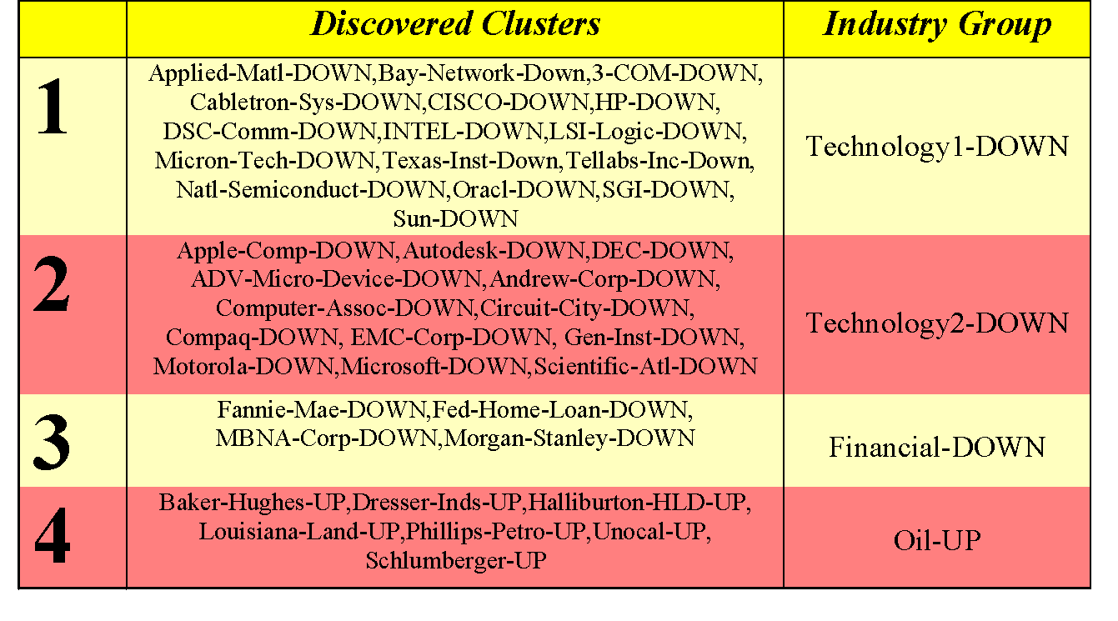
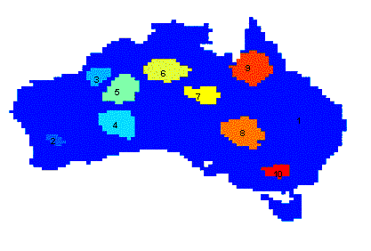
Applications of Cluster Analysis
Understanding
Group related documents for browsing, group genes and proteins that have similar functionality, or group stocks with similar price fluctuations
Summarization
Reduce the size of large data sets
Clustering precipitation in Australia

Slide 4
Supervised and Unsupervised Classification
What is Classification?
What is Supervised Classification/Learning?
What is Unsupervised Classification/Learning?
SOM – Self Organizing Maps

Slide 5
Types of Clustering Algorithms
Clustering has been a popular area of research
Several methods and techniques have been developed to determine natural grouping among the objects
Jain, A. K., Murty, M. N., and Flynn, P. J., Data Clustering: A Survey. ACM Computing Surveys, 1999. 31: pp. 264-323.
Jain, A. K. and Dubes, R. C., Algorithms for Clustering Data. 1988,
Englewood Cliffs, NJ: Prentice Hall. 013022278X

Slide 6
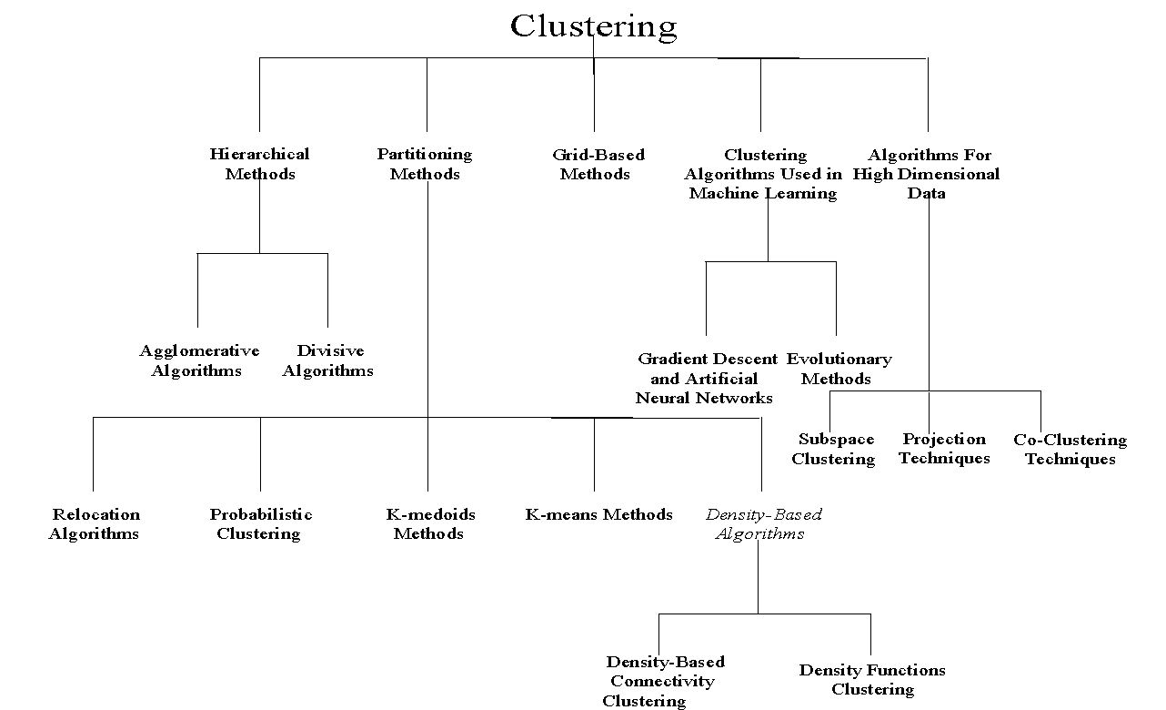
Types of Clustering Algorithms

Slide 7
Classification vs. Clustering
Classification:
Supervised learning:
Learns a method for predicting the instance class from pre-labeled (classified) instances

Slide 8
Idea and Applications
Clustering is the process of grouping a set of physical or abstract objects into classes of similar objects.
It is also called unsupervised learning.
It is a common and important task that finds many applications.
Applications in Search engines:
Structuring search results
Suggesting related pages
Automatic directory construction/update
Finding near identical/duplicate pages

Slide 9
When & From What
Clustering can be done at:
Indexing time
At query time
Applied to documents
Applied to snippets
Clustering can be based on:
URL source
Put pages from the same server together
Text Content
-Polysemy (“puma”, “banks”)
-Multiple aspects of a single topic
Links
-Look at the connected components in the link graph (A/H analysis can do it)

Slide 10
What is not Cluster Analysis?
Supervised classification
Have class label information
Simple segmentation
Dividing students into different registration groups alphabetically, by last name
Results of a query
Groupings are a result of an external specification
Graph partitioning
Some mutual relevance and synergy, but areas are not identical

Slide 11
Notion of a Cluster can be Ambiguous
How many clusters?
Six Clusters
Two Clusters
Four Clusters

Slide 12
Clustering for Data Understanding and Applications
Biology: taxonomy of living things: kingdom, phylum, class, order, family, genus and species
Information retrieval: document clustering
Land use: Identification of areas of similar land use in an earth observation database
Marketing: Help marketers discover distinct groups in their customer bases, and then use this knowledge to develop targeted marketing programs
City-planning: Identifying groups of houses according to their house type, value, and geographical location
Earth-quake studies: Observed earth quake epicenters should be clustered along continent faults
Climate: understanding earth climate, find patterns of atmospheric and ocean
Economic Science: market research

Slide 13
Types of Clusterings
A clustering is a set of clusters
Important distinction between hierarchical and partitional sets of clusters
Partitional Clustering
A division data objects into non-overlapping subsets (clusters) such that each data object is in exactly one subset
Hierarchical clustering
A set of nested clusters organized as a hierarchical tree

Slide 14
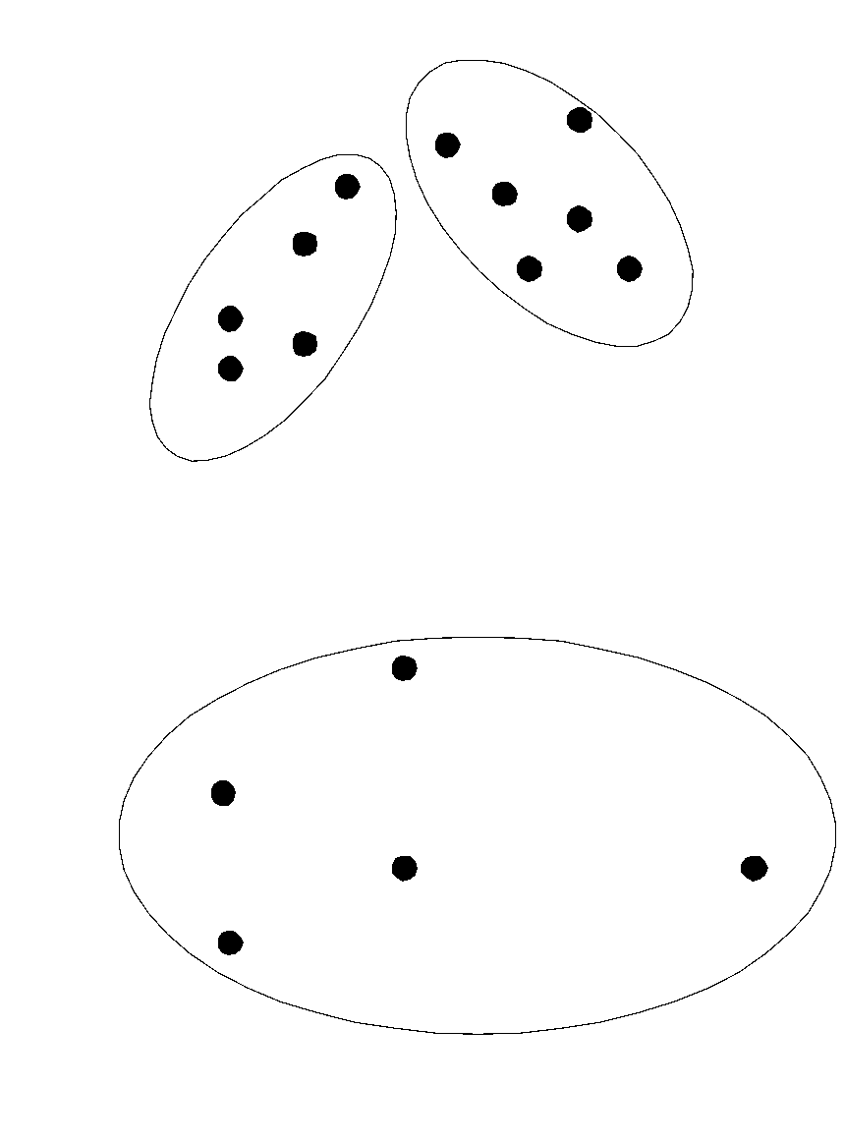
Partitional Clustering
Original Points
A Partitional Clustering

Slide 15
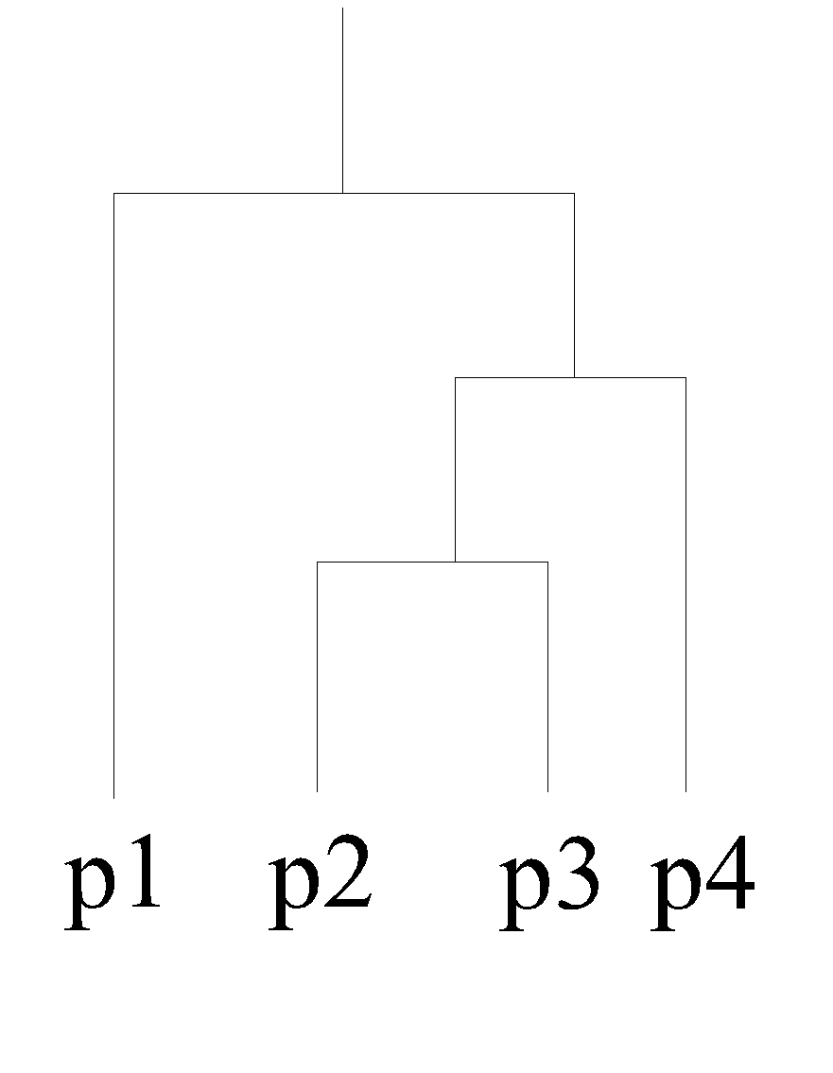
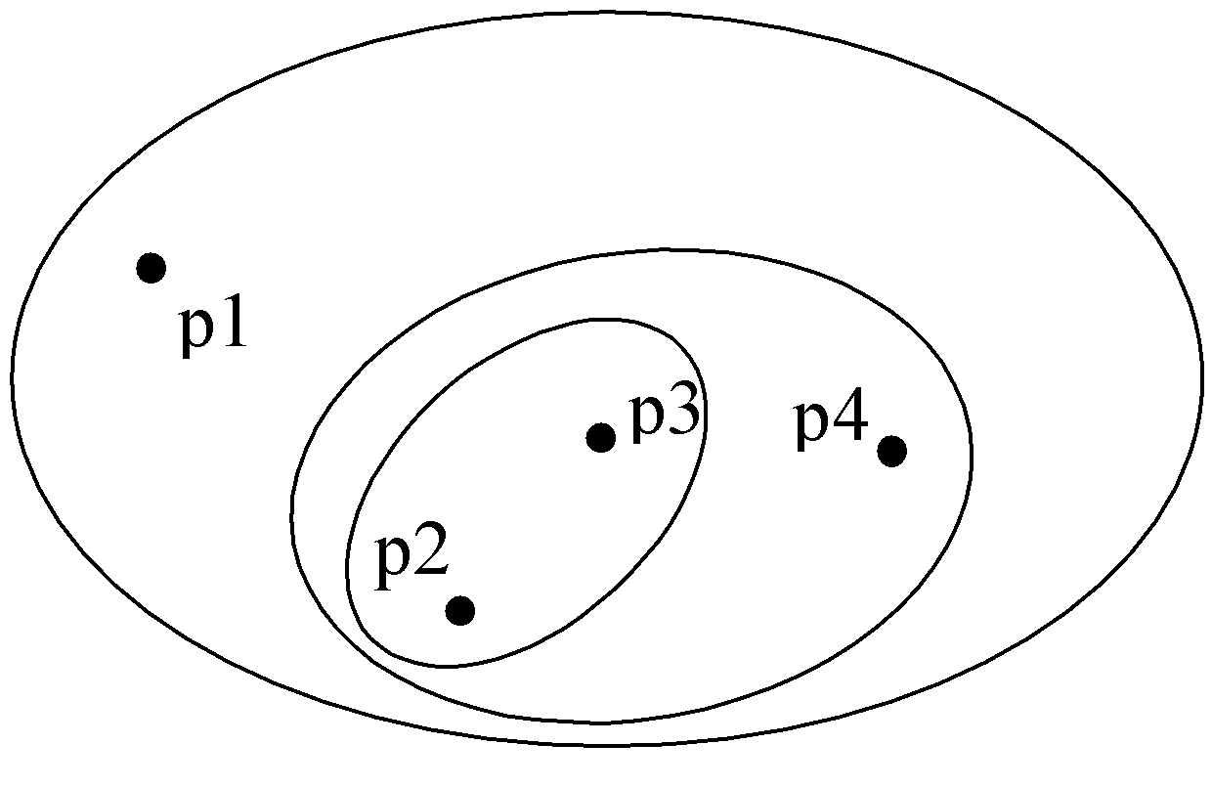
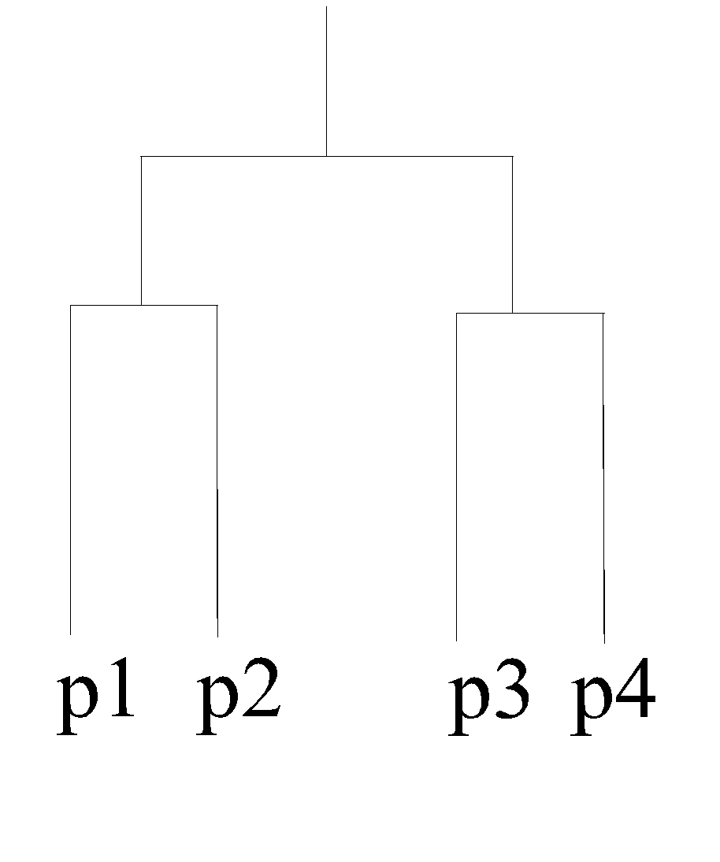
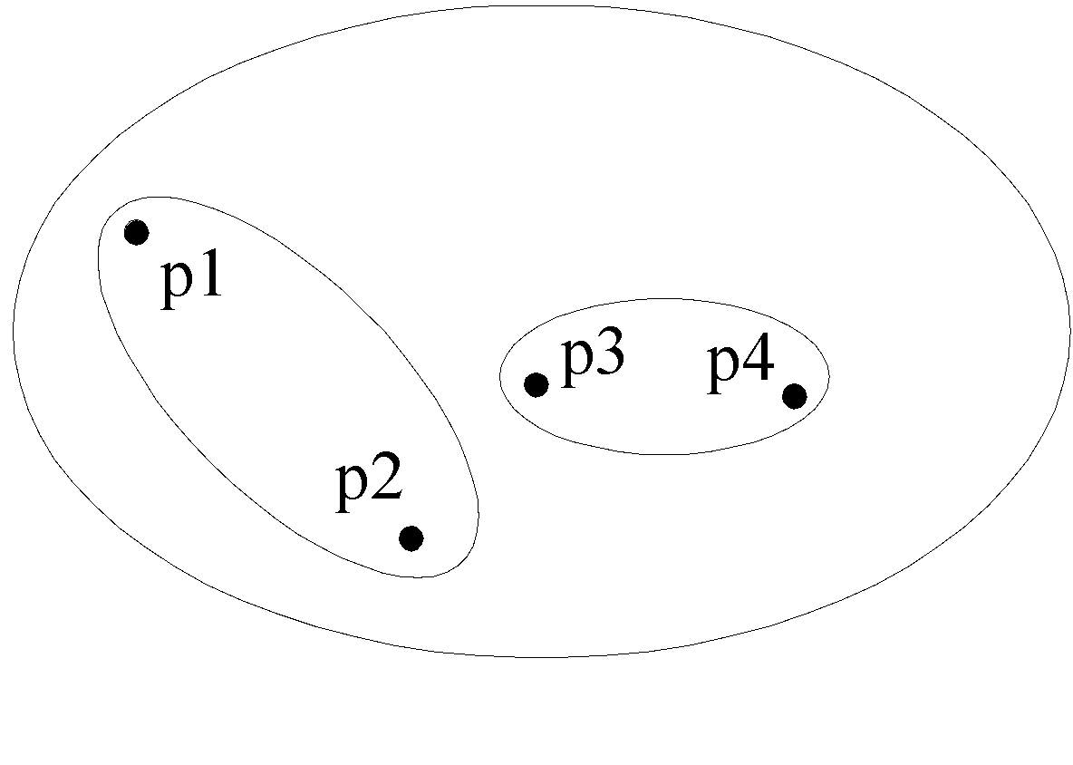
Hierarchical Clustering
Traditional Hierarchical Clustering
Traditional Dendrogram
Non-traditional Hierarchical Clustering
Non-traditional Dendrogram

Slide 16
Other Distinctions Between Sets of Clusters
Exclusive versus non-exclusive
In non-exclusive clusterings, points may belong to multiple clusters.
Can represent multiple classes or ‘border’ points
Fuzzy versus non-fuzzy
In fuzzy clustering, a point belongs to every cluster with some weight between 0 and 1
Weights must sum to 1
Probabilistic clustering has similar characteristics
Partial versus complete
In some cases, we only want to cluster some of the data
Heterogeneous versus homogeneous
Cluster of widely different sizes, shapes, and densities

Slide 17
Types of Clusters
Well-separated clusters
Center-based clusters
Contiguous clusters
Density-based clusters
Property or Conceptual
Described by an Objective Function

Slide 18
Types of Clusters: Well-Separated
Well-Separated Clusters:
A cluster is a set of points such that any point in a cluster is closer (or more similar) to every other point in the cluster than to any point not in the cluster.
3 well-separated clusters

Slide 19
Types of Clusters: Center-Based
Center-based
A cluster is a set of objects such that an object in a cluster is closer (more similar) to the “center” of a cluster, than to the center of any other cluster
The center of a cluster is often a centroid, the average of all the points in the cluster, or a medoid, the most “representative” point of a cluster
4 center-based clusters

Slide 20
Types of Clusters: Contiguity-Based
Contiguous Cluster (Nearest neighbor or Transitive)
A cluster is a set of points such that a point in a cluster is closer (or more similar) to one or more other points in the cluster than to any point not in the cluster.
8 contiguous clusters

Slide 21
Types of Clusters: Density-Based
Density-based
A cluster is a dense region of points, which is separated by low-density regions, from other regions of high density.
Used when the clusters are irregular or intertwined, and when noise and outliers are present.
6 density-based clusters

Slide 22
Types of Clusters: Conceptual Clusters
Shared Property or Conceptual Clusters
Finds clusters that share some common property or represent a particular concept.
.
2 Overlapping Circles

Slide 23
Types of Clusters: Objective Function
Clusters Defined by an Objective Function
Finds clusters that minimize or maximize an objective function.
Enumerate all possible ways of dividing the points into clusters and evaluate the `goodness' of each potential set of clusters by using the given objective function. (NP Hard)
Can have global or local objectives.
Hierarchical clustering algorithms typically have local objectives
Partitional algorithms typically have global objectives
A variation of the global objective function approach is to fit the data to a parameterized model.
Parameters for the model are determined from the data.
Mixture models assume that the data is a ‘mixture' of a number of statistical distributions.

Slide 24
Types of Clusters: Objective Function …
Map the clustering problem to a different domain and solve a related problem in that domain
Proximity matrix defines a weighted graph, where the nodes are the points being clustered, and the weighted edges represent the proximities between points
Clustering is equivalent to breaking the graph into connected components, one for each cluster.
Want to minimize the edge weight between clusters and maximize the edge weight within clusters

Slide 25
Characteristics of the Input Data Are Important
Type of proximity or density measure
This is a derived measure, but central to clustering
Sparseness
Dictates type of similarity
Adds to efficiency
Attribute type
Dictates type of similarity
Type of Data
Dictates type of similarity
Other characteristics, e.g., autocorrelation
Dimensionality
Noise and Outliers
Type of Distribution

Slide 26
Inter/Intra Cluster Distances
Intra-cluster distance
(Sum/Min/Max/Avg) the (absolute/squared) distance between
All pairs of points in the cluster OR
Between the centroid and all points in the cluster OR
Between the “medoid” and all points in the cluster
Inter-cluster distance
Sum the (squared) distance between all pairs of clusters
Where distance between two clusters is defined as:
distance between their centroids/medoids
(Spherical clusters)
Distance between the closest pair of points belonging to the clusters
(Chain shaped clusters)

Slide 27
How hard is clustering?
One idea is to consider all possible clusterings, and pick the one that has best inter and intra cluster distance properties
Suppose we are given n points, and would like to cluster them into k-clusters
How many possible clusterings?
Too hard to do it brute force or optimally
Solution: Iterative optimization algorithms
Start with a clustering, iteratively improve it (eg. K-means)

Slide 28
Quality: What Is Good Clustering?
A good clustering method will produce high quality clusters
high intra-class similarity: cohesive within clusters
low inter-class similarity: distinctive between clusters
Quality of a clustering method depends on
the similarity measure used by the method
its implementation, and
its ability to discover some or all of the hidden patterns

Slide 29
Measure the Quality of Clustering
Dissimilarity/Similarity metric
Similarity is expressed in terms of a distance function, typically metric: d(i, j)
Definitions of distance functions are usually rather different for interval-scaled, boolean, categorical, ordinal ratio, and vector variables
Weights should be associated with different variables based on applications and data semantics
Quality of clustering:
There is usually a separate “quality” function that measures the “goodness” of a cluster
It is hard to define “similar enough” or “good enough”
Answer is typically highly subjective

Slide 30
Requirements and Challenges
Scalability
Clustering all the data instead of only on samples
Ability to deal with different types of attributes
Numerical, binary, categorical, ordinal, linked, and mixture of these
Constraint-based clustering
User may give constraints
Use domain knowledge to determine input parameters
Interpretability and usability
Others
Discovery of clusters with arbitrary shape
Ability to deal with noisy data
Incremental clustering and insensitivity to input order
High dimensionality

Slide 31
Sec. 16.2
Issues for clustering
Representation for clustering
Document representation
Vector space? Normalization?
Centroids aren’t length normalized
Need a notion of similarity/distance
How many clusters?
Fixed a priori?
Completely data driven?
Avoid “trivial” clusters - too large or small
If a cluster's too large, then for navigation purposes you've wasted an extra user click without whittling down the set of documents much.

Slide 32
Notion of similarity/distance
Ideal: semantic similarity.
Practical: term-statistical similarity
We will use cosine similarity.
Docs as vectors.
For many algorithms, easier to think in terms of a distance (rather than similarity) between docs.
We will mostly speak of Euclidean distance
But real implementations use cosine similarity

Slide 33
Clustering Algorithms
K-means and its variants
Hierarchical clustering
Density-based clustering

Slide 34
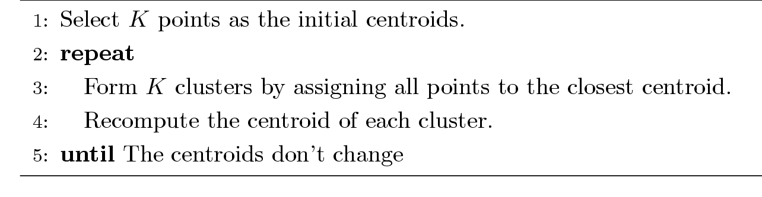
K-means Clustering
Partitional clustering approach
Each cluster is associated with a centroid (center point)
Each point is assigned to the cluster with the closest centroid
Number of clusters, K, must be specified
The basic algorithm is very simple

Slide 35
K-means example, step 1
k₁
Y
Pick 3
initial
cluster
centers
(randomly)
k₂
k₃
X

Slide 36
K-means example, step 2
k₁
Y
k₂
Assign
each point
to the closest
cluster
center
k₃
X

Slide 37
K-means example, step 3
k₁
k₁
Y
Move
each cluster center
to the mean
of each cluster
k₂
k₃
k₂
k₃
X

Slide 38
K-means example, step 4
Reassign
points
closest to a different new cluster center
Q: Which points are reassigned?
k₁
Y
k₃
k₂
X

Slide 39
K-means example, step 4 …
k₁
Y
A: three points with animation
k₃
k₂
X

Slide 40
K-means example, step 4b
k₁
Y
re-compute cluster means
k₃
k₂
X

Slide 41
K-means example, step 5
k₁
Y
k₂
move cluster centers to cluster means
k₃
X

Slide 42
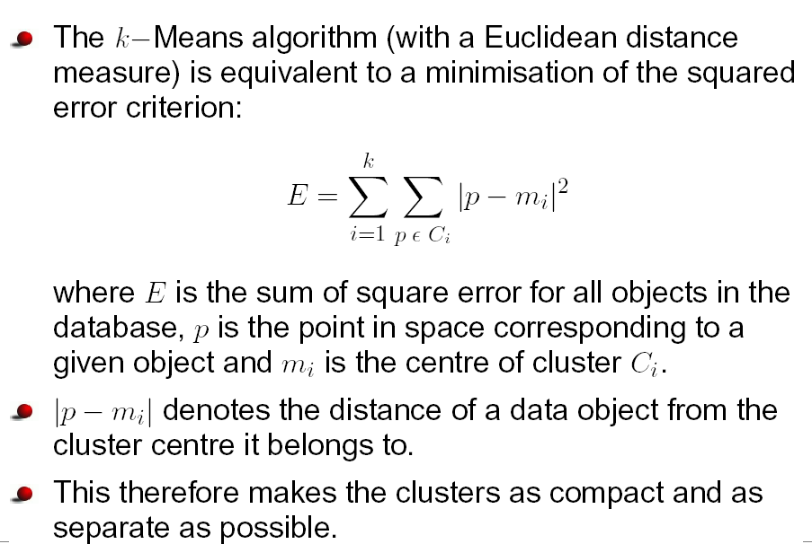
Squared Error Criterion

Slide 43
K-means Clustering – Details
Initial centroids are often chosen randomly.
Clusters produced vary from one run to another.
The centroid is (typically) the mean of the points in the cluster.
‘Closeness’ is measured by Euclidean distance, cosine similarity, correlation, etc.
K-means will converge for common similarity measures mentioned above.
Most of the convergence happens in the first few iterations.
Often the stopping condition is changed to ‘Until relatively few points change clusters’
Complexity is O( n * K * I * d )
n = number of points, K = number of clusters, I = number of iterations, d = number of attributes

Slide 44
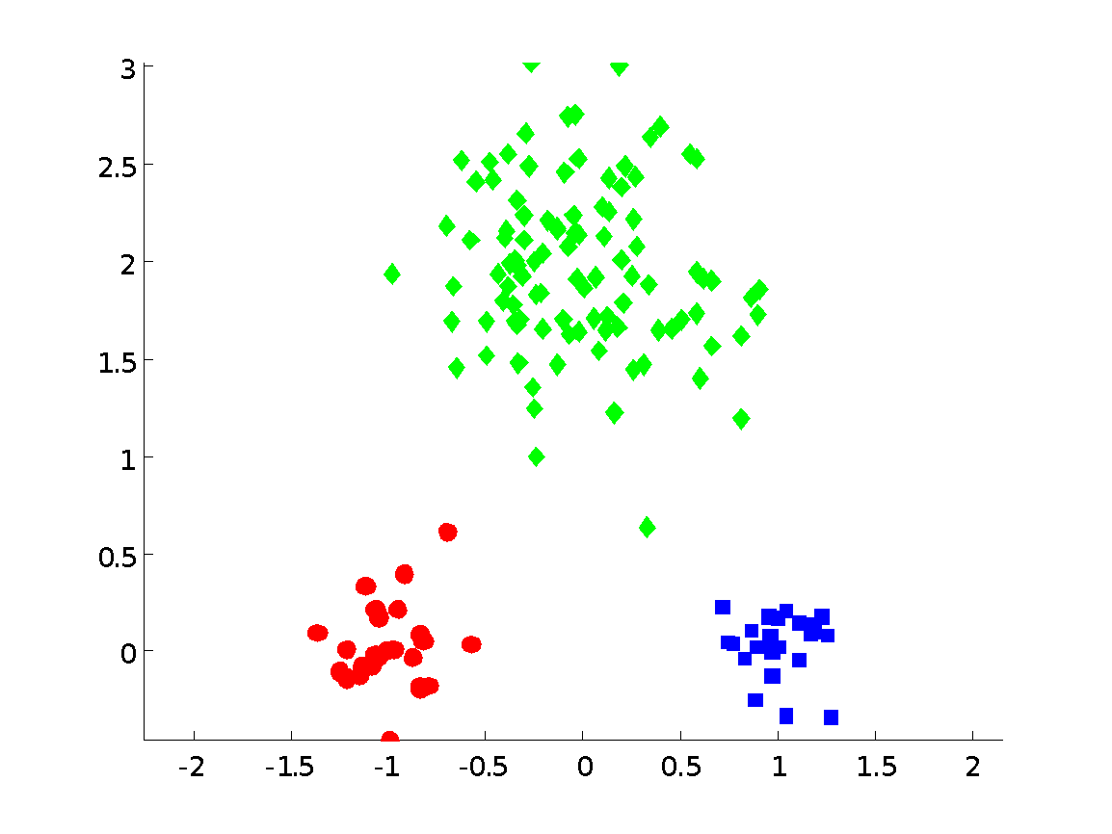
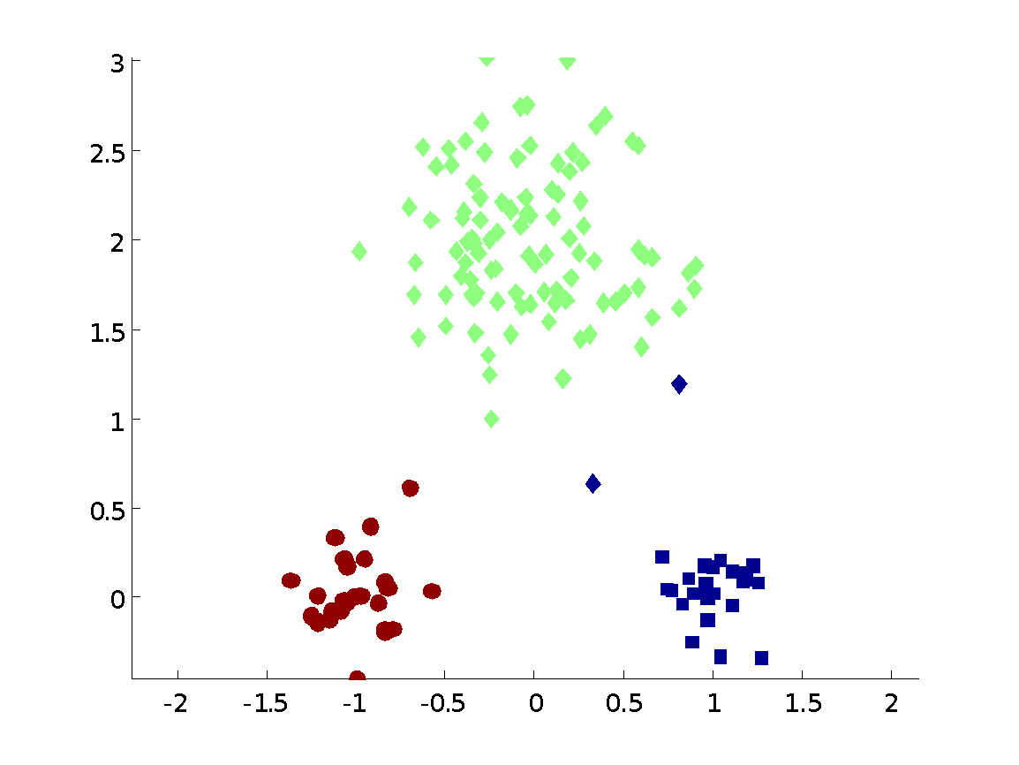
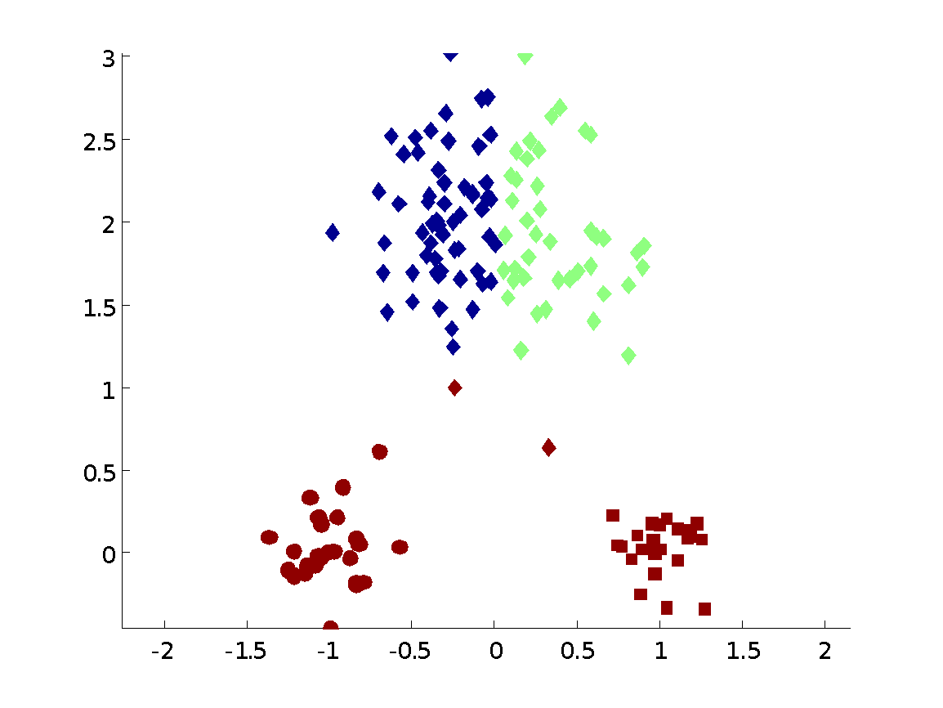
Two different K-means Clusterings
Original Points
Optimal Clustering
Sub-optimal Clustering

Slide 45
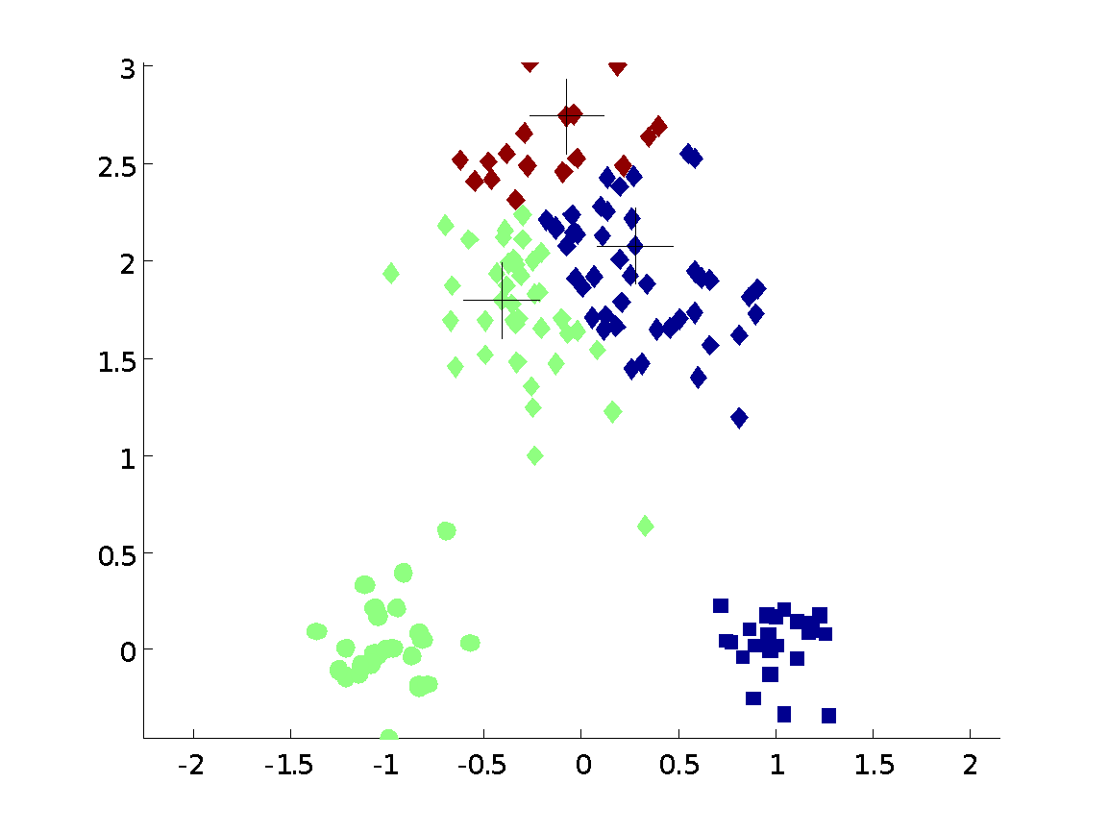
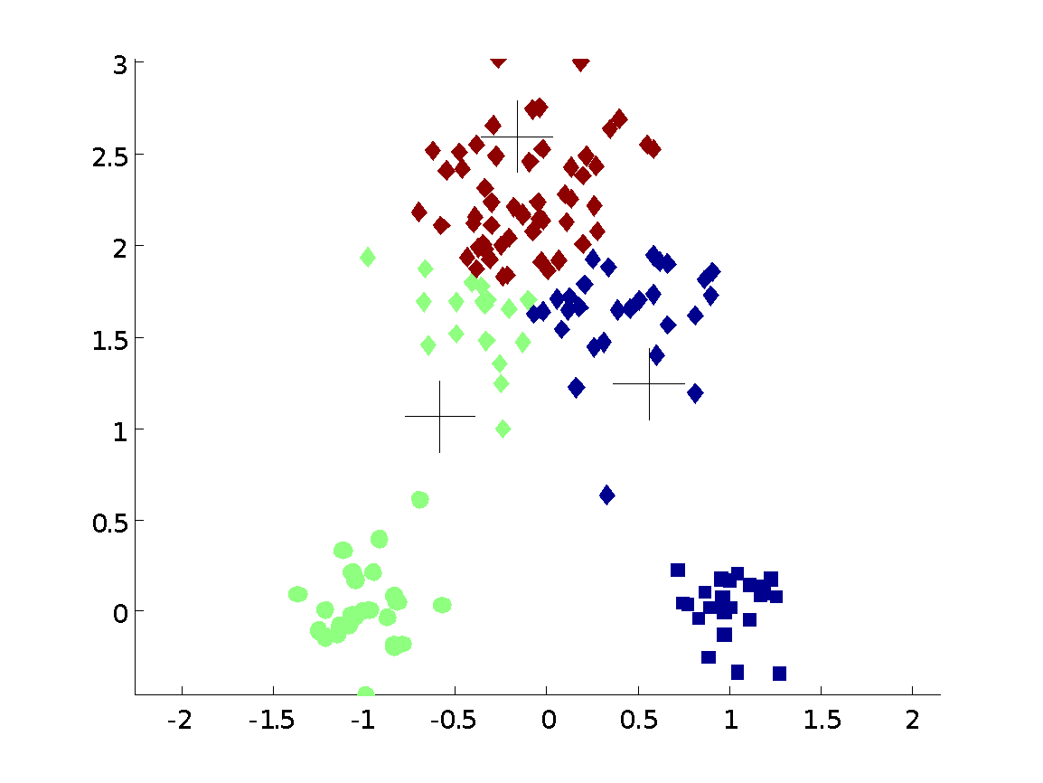
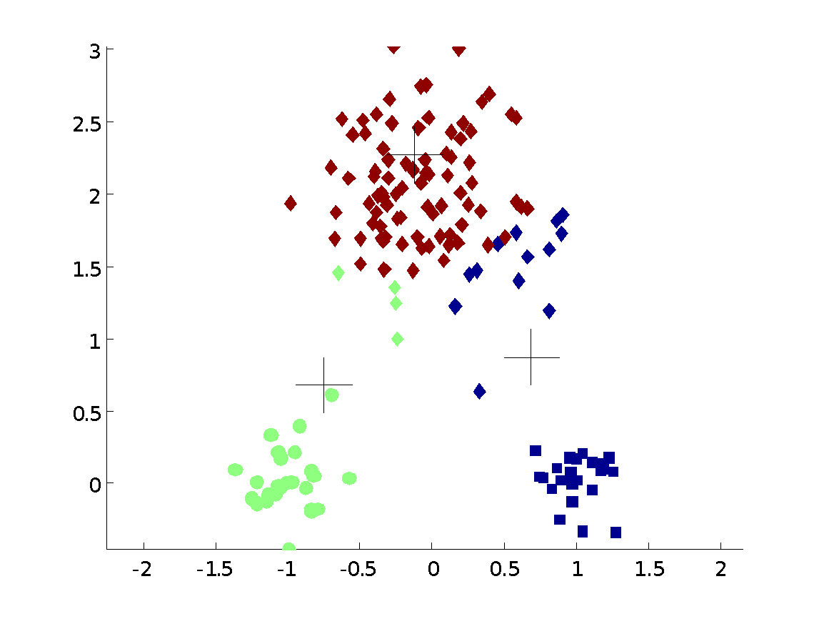
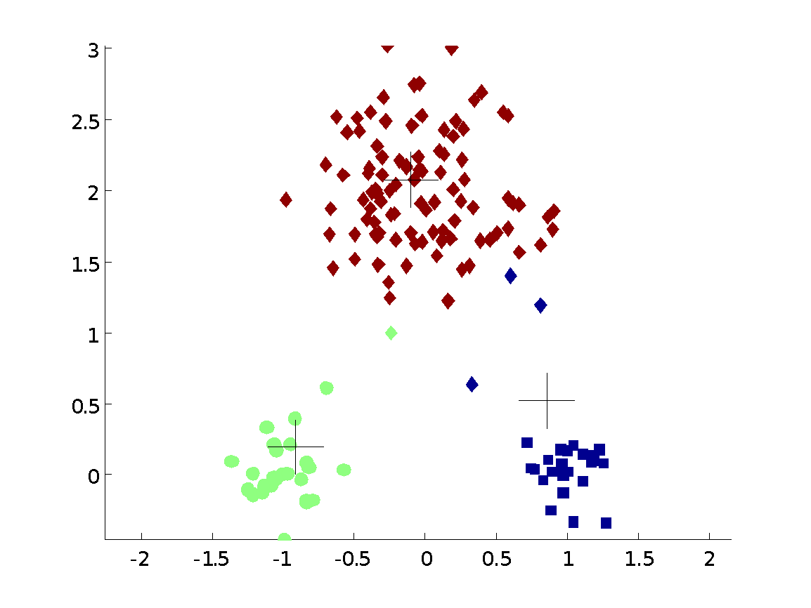


Importance of Choosing Initial Centroids

Slide 46
Importance of Choosing Initial Centroids

Slide 47
Evaluating K-means Clusters
Most common measure is Sum of Squared Error (SSE)
For each point, the error is the distance to the nearest cluster
To get SSE, we square these errors and sum them.
x is a data point in cluster C_{i} and m_{i} is the representative point for cluster C_{i}
can show that m_{i} corresponds to the center (mean) of the cluster
Given two clusters, we can choose the one with the smallest error
One easy way to reduce SSE is to increase K, the number of clusters
A good clustering with smaller K can have a lower SSE than a poor clustering with higher K

Slide 48
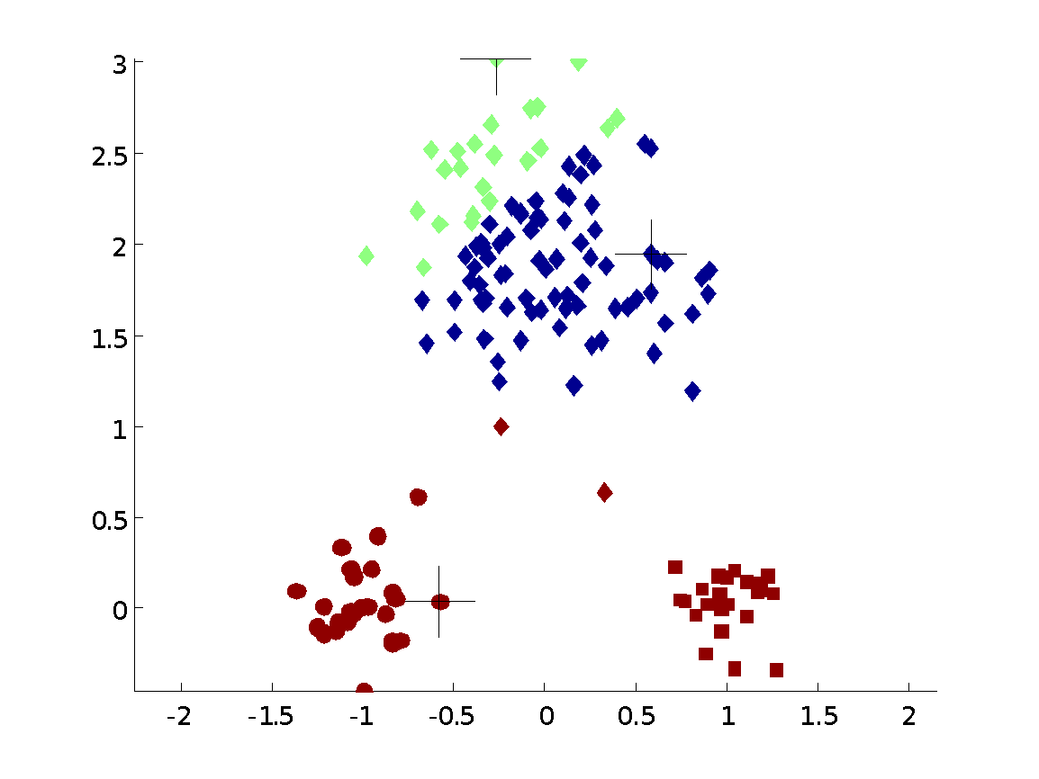
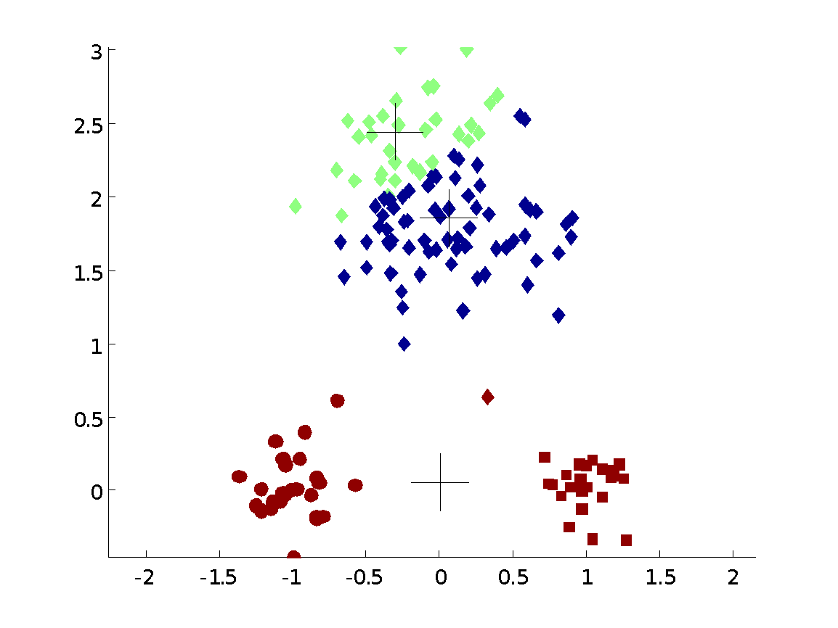
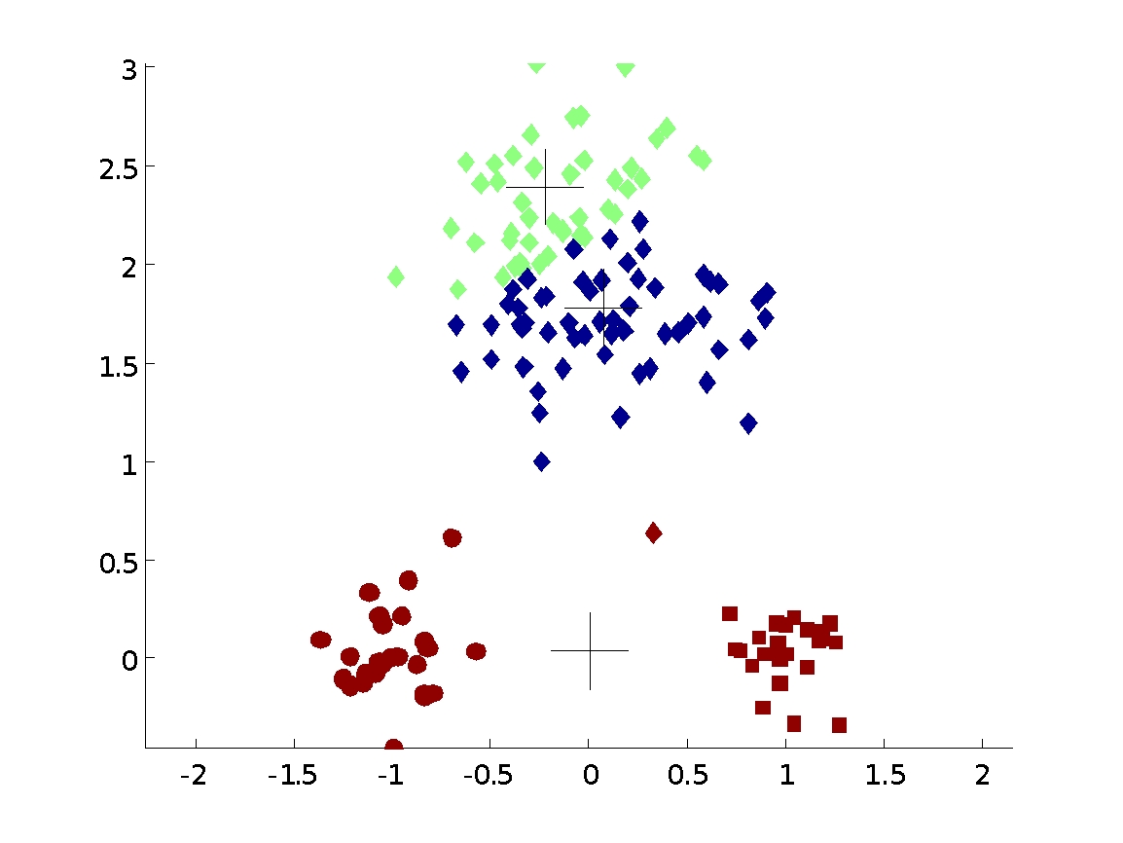
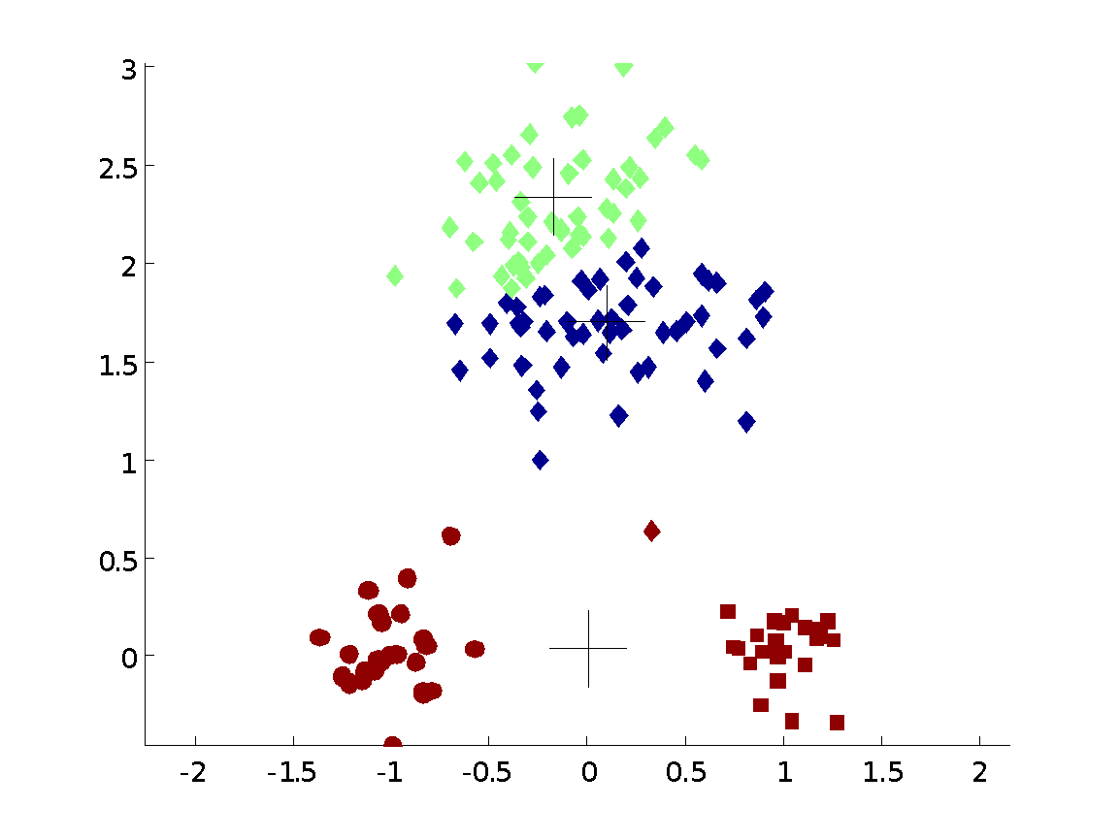

Importance of Choosing Initial Centroids …

Slide 49
Importance of Choosing Initial Centroids …

Slide 50
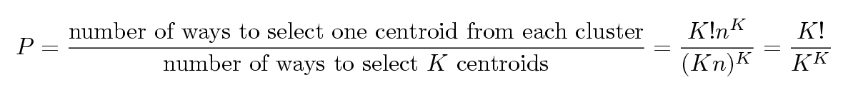
Problems with Selecting Initial Points
If there are K ‘real’ clusters then the chance of selecting one centroid from each cluster is small.
Chance is relatively small when K is large
If clusters are the same size, n, then
For example, if K = 10, then probability = 10!/10¹⁰ = 0.00036
Sometimes the initial centroids will readjust themselves in ‘right’ way, and sometimes they don’t
Consider an example of five pairs of clusters

Slide 51
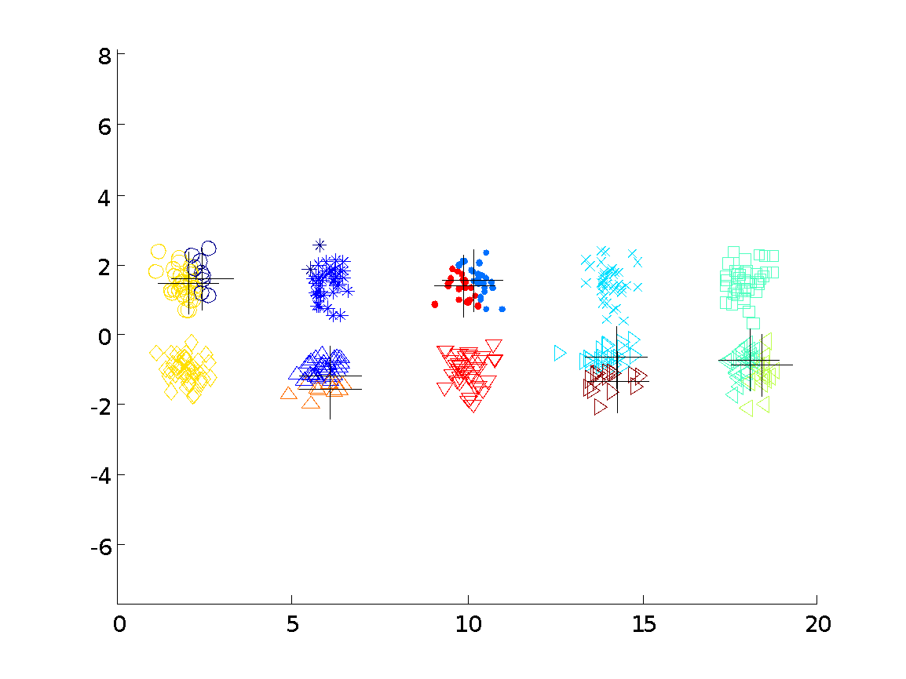
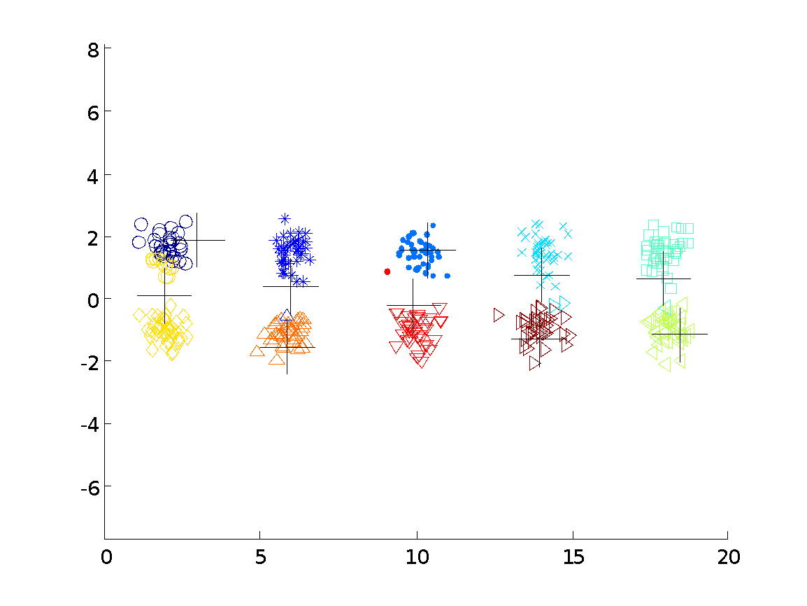
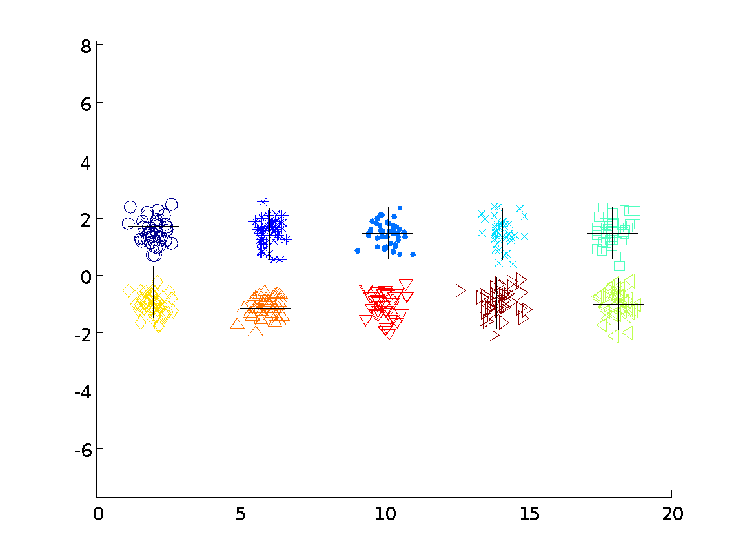

10 Clusters Example
Starting with two initial centroids in one cluster of each pair of clusters

Slide 52
10 Clusters Example
Starting with two initial centroids in one cluster of each pair of clusters

Slide 53
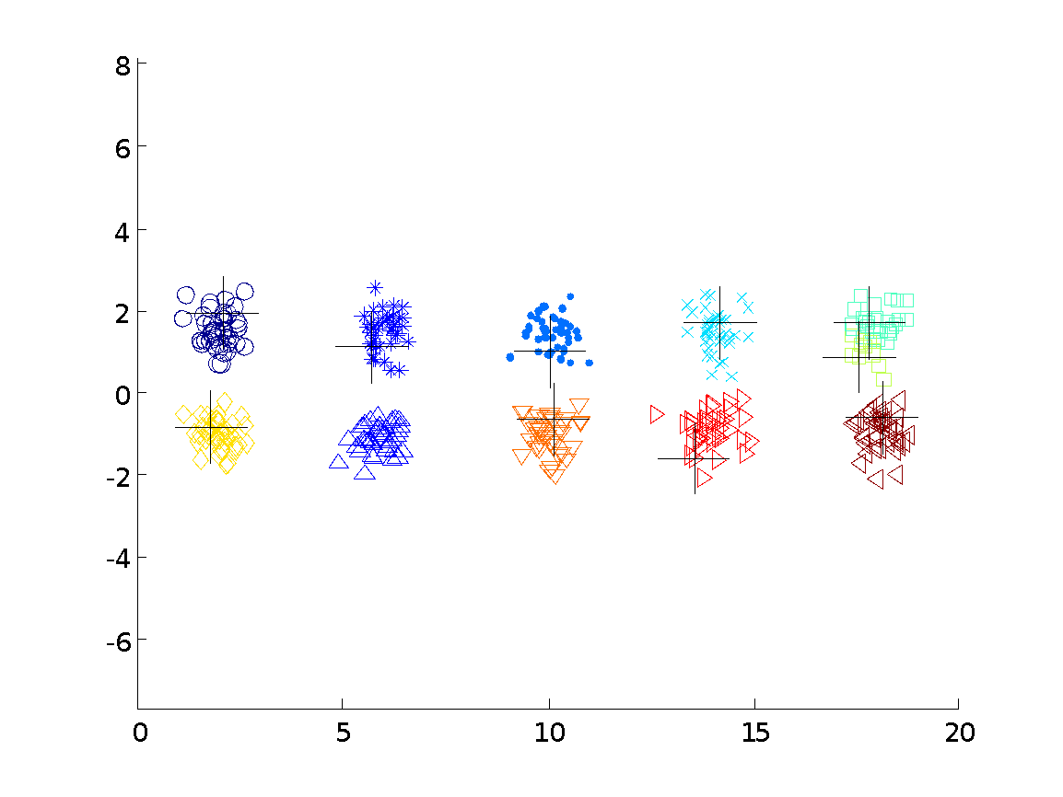



10 Clusters Example
Starting with some pairs of clusters having three initial centroids, while other have only one.

Slide 54
10 Clusters Example
Starting with some pairs of clusters having three initial centroids, while other have only one.

Slide 55
Solutions to Initial Centroids Problem
Multiple runs
Helps, but probability is not on your side
Sample and use hierarchical clustering to determine initial centroids
Select more than k initial centroids and then select among these initial centroids
Select most widely separated
Postprocessing
Bisecting K-means
Not as susceptible to initialization issues

Slide 56
Handling Empty Clusters
Basic K-means algorithm can yield empty clusters
Several strategies
Choose the point that contributes most to SSE
Choose a point from the cluster with the highest SSE
If there are several empty clusters, the above can be repeated several times.

Slide 57
Updating Centers Incrementally
In the basic K-means algorithm, centroids are updated after all points are assigned to a centroid
An alternative is to update the centroids after each assignment (incremental approach)
Each assignment updates zero or two centroids
More expensive
Introduces an order dependency
Never get an empty cluster
Can use “weights” to change the impact

Slide 58
Pre-processing and Post-processing
Pre-processing
Normalize the data
Eliminate outliers
Post-processing
Eliminate small clusters that may represent outliers
Split ‘loose’ clusters, i.e., clusters with relatively high SSE
Merge clusters that are ‘close’ and that have relatively low SSE
Can use these steps during the clustering process
ISODATA

Slide 59
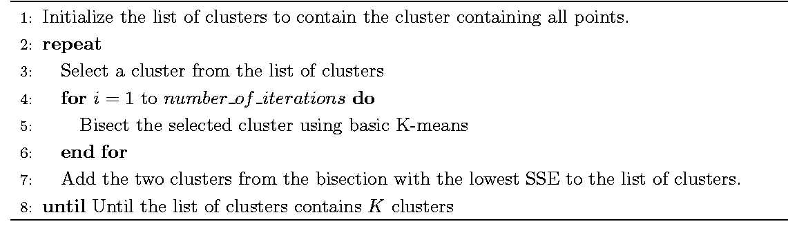
Bisecting K-means
Bisecting K-means algorithm
Variant of K-means that can produce a partitional or a hierarchical clustering

Slide 60
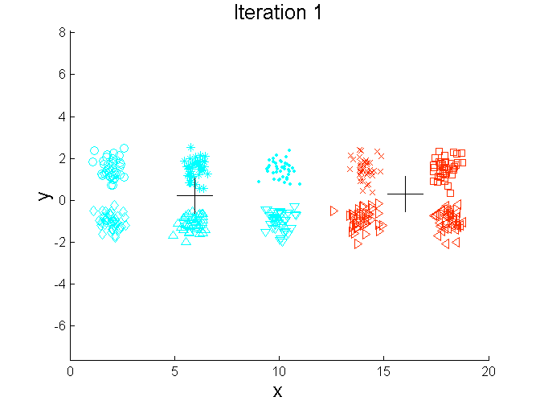
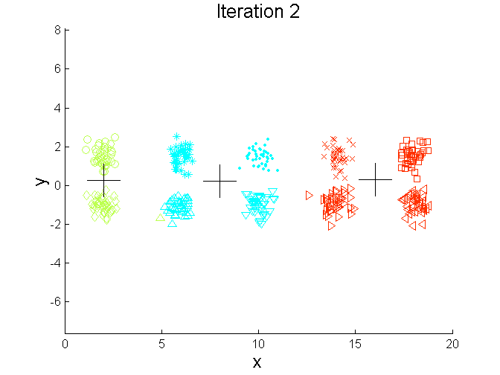
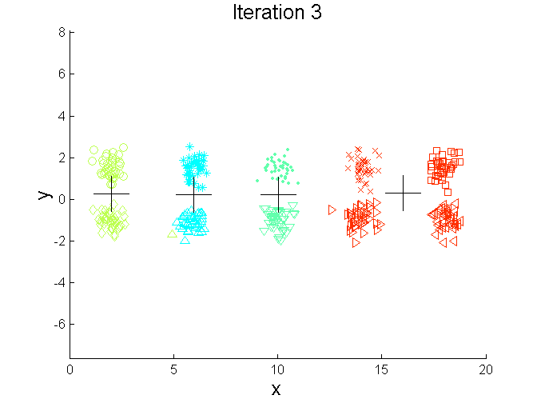
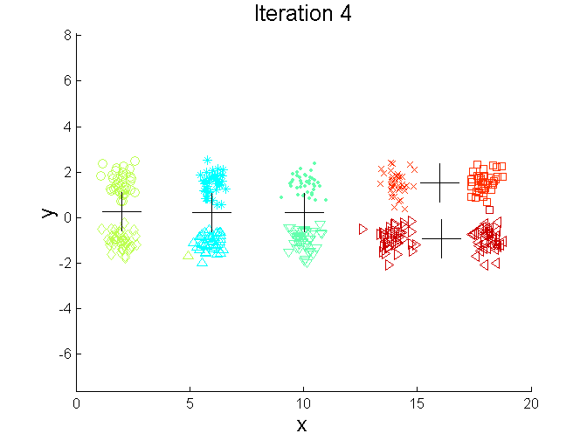
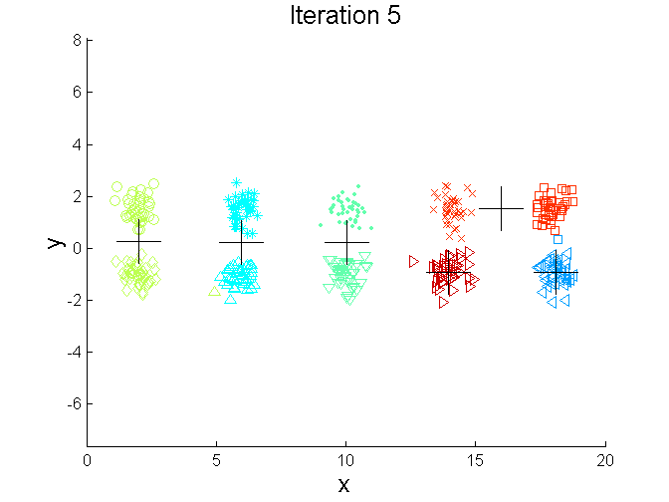
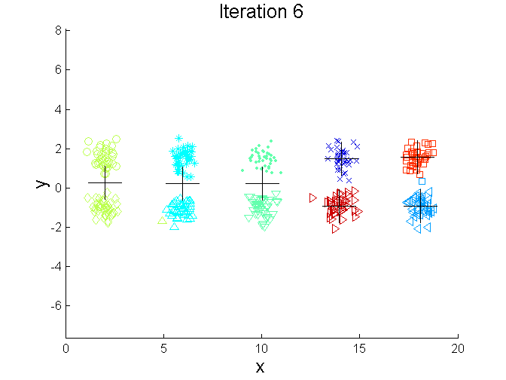
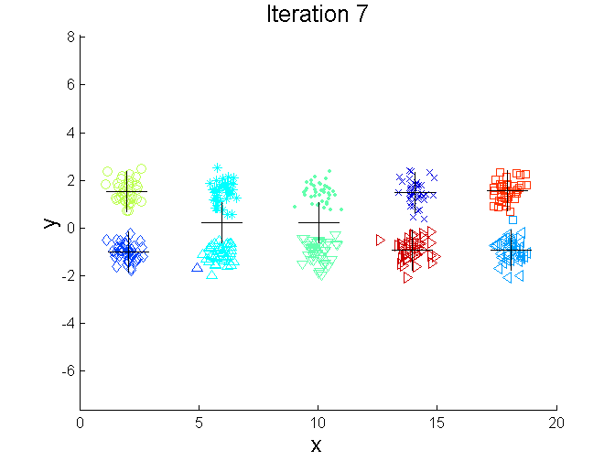
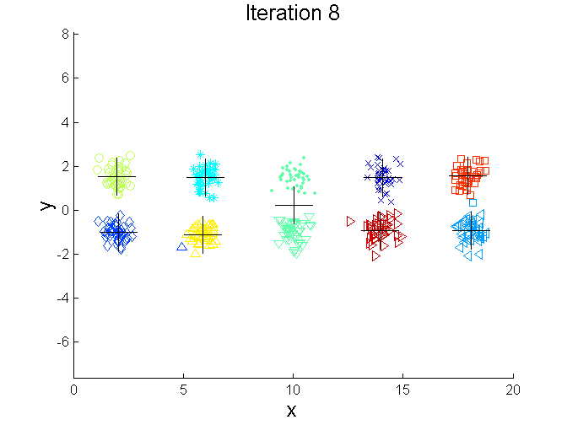
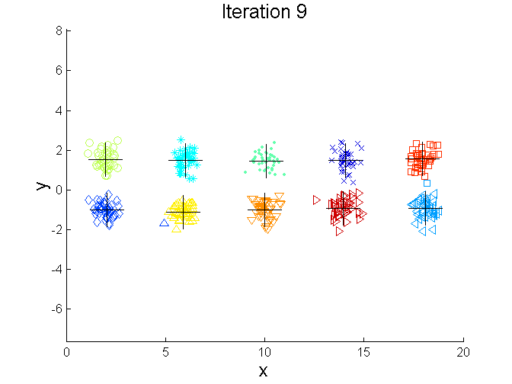
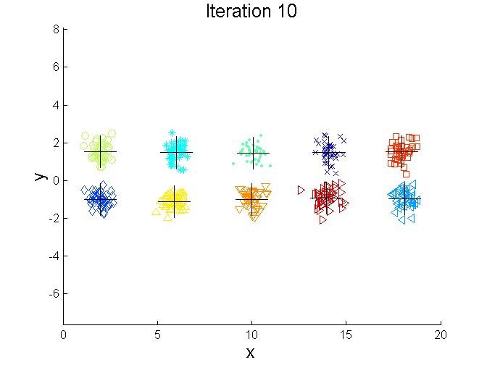
Bisecting K-means Example

Slide 61
Limitations of K-means
K-means has problems when clusters are of differing
Sizes
Densities
Non-globular shapes
K-means has problems when the data contains outliers.

Slide 62
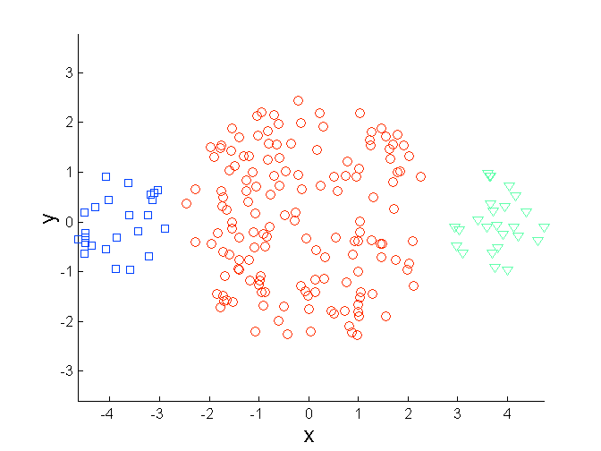
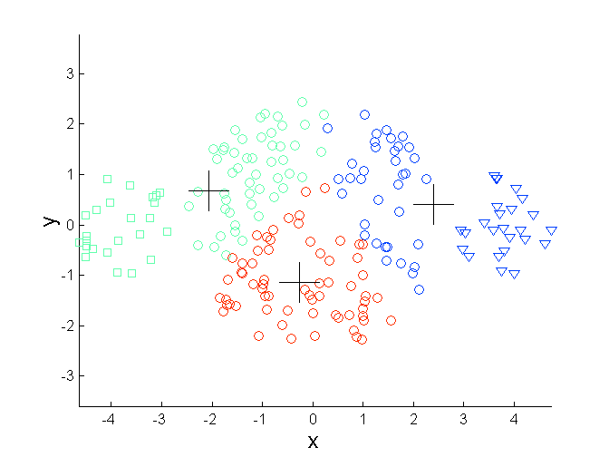
Limitations of K-means: Differing Sizes
Original Points
K-means (3 Clusters)

Slide 63
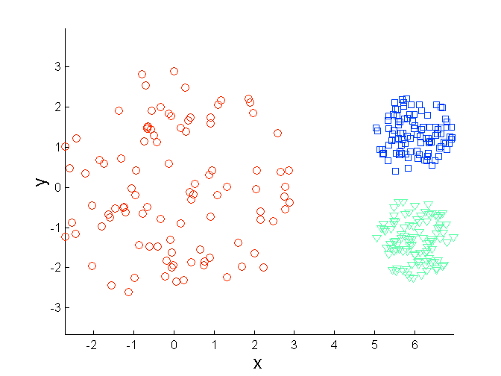
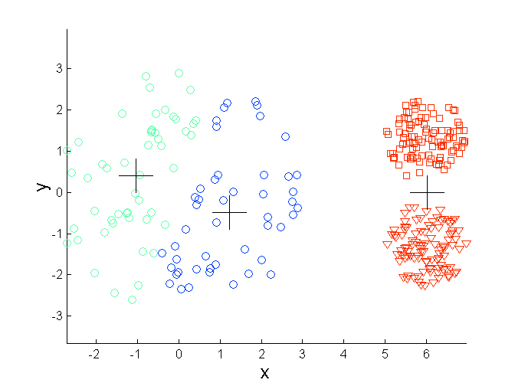
Limitations of K-means: Differing Density
Original Points
K-means (3 Clusters)

Slide 64
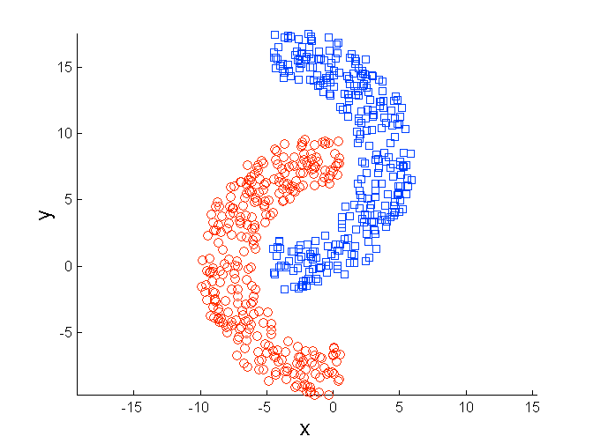
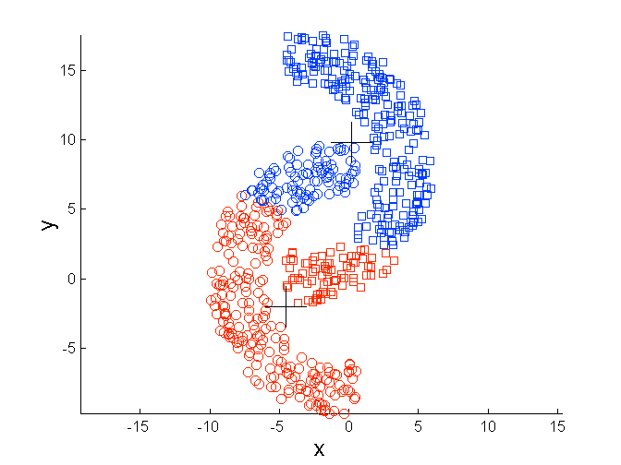
Limitations of K-means: Non-globular Shapes
Original Points
K-means (2 Clusters)

Slide 65
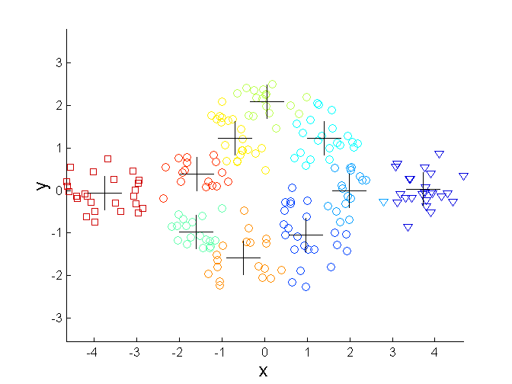
Overcoming K-means Limitations
Original Points K-means Clusters
One solution is to use many clusters.
Find parts of clusters, but need to put together.

Slide 66
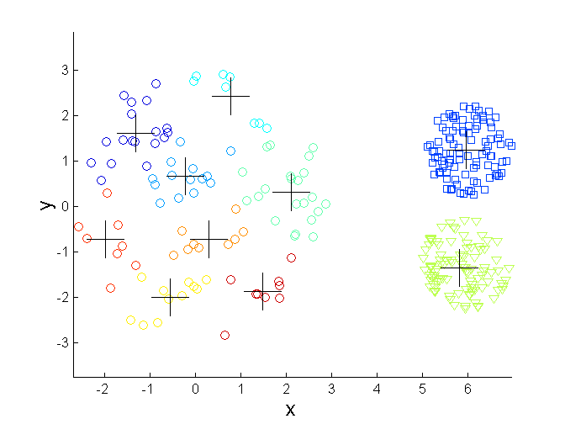
Overcoming K-means Limitations
Original Points K-means Clusters

Slide 67
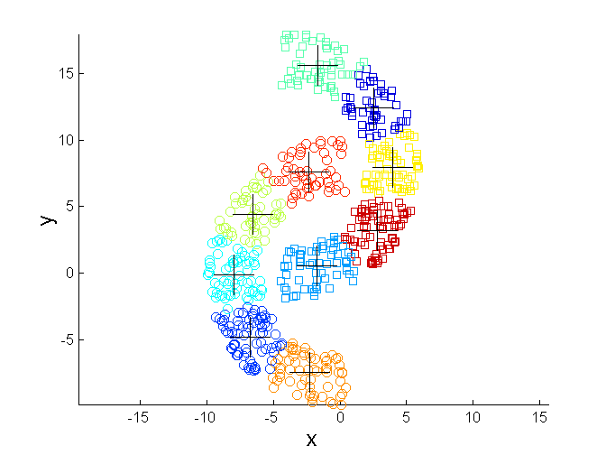
Overcoming K-means Limitations
Original Points K-means Clusters

Slide 68
K-means variations
K-medoids – instead of mean, use medians of each cluster
Mean of 1, 3, 5, 7, 9 is
Mean of 1, 3, 5, 7, 1009 is
Median of 1, 3, 5, 7, 1009 is
Median advantage: not affected by extreme values
For large databases, use sampling
5
205
5

Slide 69
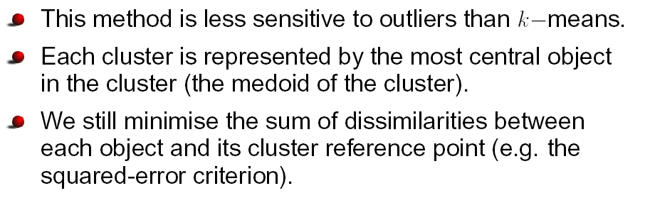
k-Medoids

Slide 70
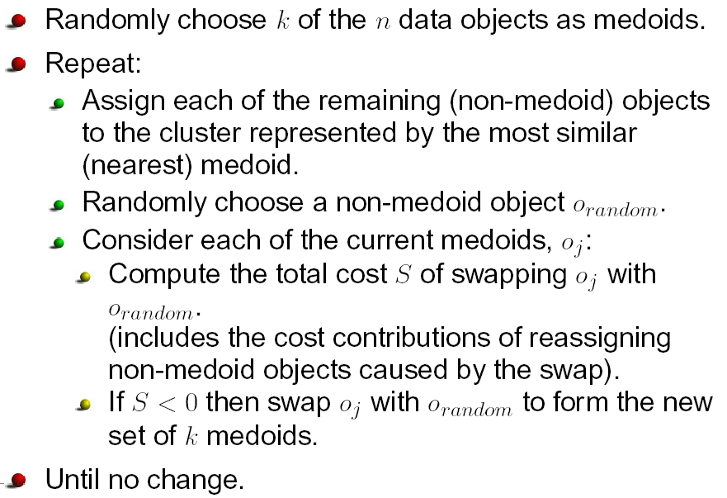
The k-Medoids Algorithm

Slide 71
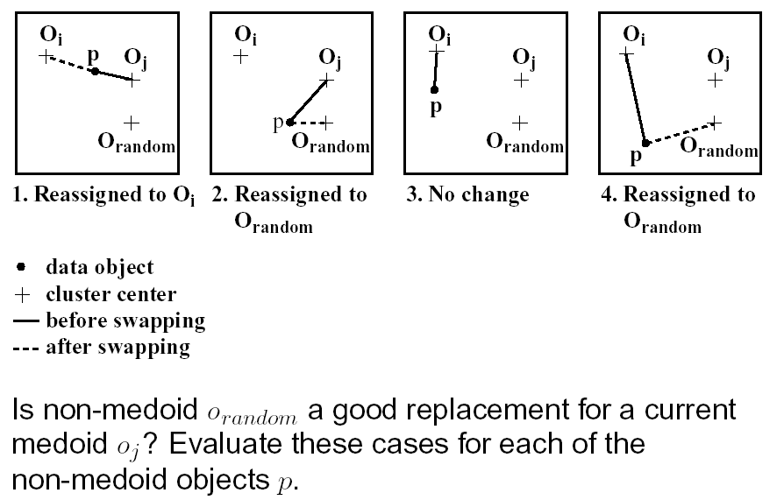
Evaluating Cost of Swapping Medoids

Slide 72
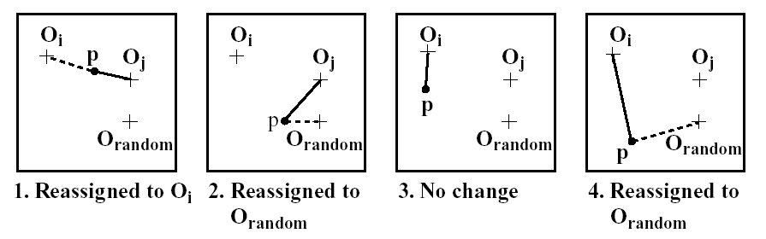
Evaluating Cost of Swapping Medoids

Slide 73

Four Cases

Slide 74


Hierarchical Clustering
Produces a set of nested clusters organized as a hierarchical tree
Can be visualized as a dendrogram
A tree like diagram that records the sequences of merges or splits

Slide 75
Strengths of Hierarchical Clustering
Do not have to assume any particular number of clusters
Any desired number of clusters can be obtained by ‘cutting’ the dendogram at the proper level
They may correspond to meaningful taxonomies
Example in biological sciences (e.g., animal kingdom, phylogeny reconstruction, …)

Slide 76
Hierarchical Clustering
Two main types of hierarchical clustering
Agglomerative:
Start with the points as individual clusters
At each step, merge the closest pair of clusters until only one cluster (or k clusters) left
Divisive:
Start with one, all-inclusive cluster
At each step, split a cluster until each cluster contains a point (or there are k clusters)
Traditional hierarchical algorithms use a similarity or distance matrix
Merge or split one cluster at a time

Slide 77
Agglomerative Clustering Algorithm
More popular hierarchical clustering technique
Basic algorithm is straightforward
Compute the proximity matrix
Let each data point be a cluster
Repeat
Merge the two closest clusters
Update the proximity matrix
Until only a single cluster remains
Key operation is the computation of the proximity of two clusters
Different approaches to defining the distance between clusters distinguish the different algorithms

Slide 78

Starting Situation
Start with clusters of individual points and a proximity matrix
p1
p2
p3
p4
p5
. . .
p1
p2
p3
p4
p5
.
.
.
Proximity Matrix

Slide 79

Intermediate Situation
After some merging steps, we have some clusters
C1
C2
C3
C4
C5
C1
C2
C3
C3
C4
C4
C5
Proximity Matrix
C1
C2
C5

Slide 80

Intermediate Situation
We want to merge the two closest clusters (C2 and C5) and update the proximity matrix.
C1
C2
C3
C4
C5
C1
C2
C3
C3
C4
C4
C5
Proximity Matrix
C1
C2
C5

Slide 81

After Merging
The question is “How do we update the proximity matrix?”
C2 U C5
C1
C3
C4
C1
?
C2 U C5
? ? ? ?
C3
C3
?
C4
C4
?
Proximity Matrix
C1
C2 U C5

Slide 82
How to Define Inter-Cluster Similarity
p1
p2
p3
p4
p5
. . .
p1
Similarity?
p2
p3
p4
p5
MIN
MAX
Group Average
Distance Between Centroids
Other methods driven by an objective function
Ward’s Method uses squared error
.
.
.
Proximity Matrix

Slide 83
How to Define Inter-Cluster Similarity
p1
p2
p3
p4
p5
. . .
p1
p2
p3
p4
p5
MIN
MAX
Group Average
Distance Between Centroids
Other methods driven by an objective function
Ward’s Method uses squared error
.
.
.
Proximity Matrix

Slide 84
How to Define Inter-Cluster Similarity
p1
p2
p3
p4
p5
. . .
p1
p2
p3
p4
p5
MIN
MAX
Group Average
Distance Between Centroids
Other methods driven by an objective function
Ward’s Method uses squared error
.
.
.
Proximity Matrix

Slide 85
How to Define Inter-Cluster Similarity
p1
p2
p3
p4
p5
. . .
p1
p2
p3
p4
p5
MIN
MAX
Group Average
Distance Between Centroids
Other methods driven by an objective function
Ward’s Method uses squared error
.
.
.
Proximity Matrix

Slide 86
How to Define Inter-Cluster Similarity
p1
p2
p3
p4
p5
. . .
p1
×
×
p2
p3
p4
p5
MIN
MAX
Group Average
Distance Between Centroids
Other methods driven by an objective function
Ward’s Method uses squared error
.
.
.
Proximity Matrix

Slide 87

Cluster Similarity: MIN or Single Link
Similarity of two clusters is based on the two most similar (closest) points in the different clusters
Determined by one pair of points, i.e., by one link in the proximity graph.
1
2
3
4
5

Slide 88

Hierarchical Clustering: MIN
5
1
3
5
2
1
2
3
6
4
4
Nested Clusters
Dendrogram

Slide 89


Strength of MIN
Original Points
Two Clusters
Can handle non-elliptical shapes

Slide 90


Limitations of MIN
Original Points
Two Clusters
Sensitive to noise and outliers

Slide 91

Cluster Similarity: MAX or Complete Linkage
Similarity of two clusters is based on the two least similar (most distant) points in the different clusters
Determined by all pairs of points in the two clusters
1
2
3
4
5

Slide 92

Hierarchical Clustering: MAX
4
1
2
5
5
2
3
6
3
1
4
Nested Clusters
Dendrogram

Slide 93

Strength of MAX
Original Points
Two Clusters
Less susceptible to noise and outliers

Slide 94


Limitations of MAX
Original Points
Two Clusters
Tends to break large clusters
Biased towards globular clusters

Slide 95

Cluster Similarity: Group Average
Proximity of two clusters is the average of pairwise proximity between points in the two clusters.
Need to use average connectivity for scalability since total proximity favors large clusters
1
2
3
4
5

Slide 96

Hierarchical Clustering: Group Average
5
4
1
2
5
2
3
6
1
4
3
Nested Clusters
Dendrogram

Slide 97
Hierarchical Clustering: Group Average
Compromise between Single and Complete Link
Strengths
Less susceptible to noise and outliers
Limitations
Biased towards globular clusters

Slide 98
Cluster Similarity: Ward’s Method
Similarity of two clusters is based on the increase in squared error when two clusters are merged
Similar to group average if distance between points is distance squared
Less susceptible to noise and outliers
Biased towards globular clusters
Hierarchical analogue of K-means
Can be used to initialize K-means

Slide 99
Hierarchical Clustering: Comparison
5
1
4
1
3
2
5
5
5
2
1
MIN
2
MAX
2
3
6
3
3
6
1
4
4
4
5
5
1
4
1
2
2
5
2
Ward’s Method
5
2
3
6
Group Average
3
3
6
4
1
1
4
4
3

Slide 100

Agglomerative Algorithm
The Agglomerative algorithm is carried out in three steps:
Convert object attributes to distance matrix
Set each object as a cluster (thus if we have N objects, we will have N clusters at the beginning)
Repeat until number of cluster is one (or known # of clusters)
Merge two closest clusters
Update distance matrix

Slide 101





Example
Problem: clustering analysis with agglomerative algorithm
data matrix
Euclidean distance
distance matrix

Slide 102



Example
Merge two closest clusters (iteration 1)

Slide 103




Example
Update distance matrix (iteration 1)

Slide 104



Example
Merge two closest clusters (iteration 2)

Slide 105



Example
Update distance matrix (iteration 2)

Slide 106




Example
Merge two closest clusters/update distance matrix (iteration 3)

Slide 107




Example
Merge two closest clusters/update distance matrix (iteration 4)

Slide 108

Example
Final result (meeting termination condition)

Slide 109

Example
Dendrogram tree representation
In the beginning we have 6
clusters: A, B, C, D, E and F
We merge clusters D and F into
cluster (D, F) at distance 0.50
We merge cluster A and cluster B
into (A, B) at distance 0.71
We merge clusters E and (D, F)
into ((D, F), E) at distance 1.00
We merge clusters ((D, F), E) and C
into (((D, F), E), C) at distance 1.41
We merge clusters (((D, F), E), C)
and (A, B) into ((((D, F), E), C), (A, B))
at distance 2.50
The last cluster contain all the objects,
thus conclude the computation
6
lifetime
5
4
3
2
object
Notes:
For a dendrogram tree, its horizontal axis indexes all objects in a given data set, while its vertical axis expresses the lifetime of all possible cluster formation.
The lifetime of a cluster in the dendrogram is defined as a distance interval from the moment that the cluster is created to the moment that it disappears by merging with other clusters.

Slide 110
Hierarchical Clustering: Time and Space requirements
O(N²) space since it uses the proximity matrix.
N is the number of points.
O(N³) time in many cases
There are N steps and at each step the size, N², proximity matrix must be updated and searched
Complexity can be reduced to O(N² log(N) ) time for some approaches

Slide 111
Hierarchical Clustering: Problems and Limitations
Once a decision is made to combine two clusters, it cannot be undone
No objective function is directly minimized
Different schemes have problems with one or more of the following:
Sensitivity to noise and outliers
Difficulty handling different sized clusters and convex shapes
Breaking large clusters

Slide 112

Demo
Agglomerative Demo

Slide 113


Relevant Issues
How to determine the number of clusters
If the number of clusters known, termination condition is given!
The K-cluster lifetime as the range of threshold value on the dendrogram tree that leads to the identification of K clusters
Heuristic rule: cut a dendrogram tree with maximum life time

Slide 114
Conclusions
Hierarchical algorithm is a sequential clustering algorithm
With distance matrix to construct a tree of clusters (dendrogram)
Hierarchical representation without the need of knowing # of clusters (can set termination condition with known # of clusters)
Major weakness of agglomerative clustering methods
Can never undo what was done previously
Sensitive to cluster distance measures and noise/outliers
Less efficient: O (n² ), where n is the number of total objects
There are several variants to overcome its weaknesses
BIRCH: uses clustering feature tree and incrementally adjusts the quality of sub-clusters, which scales well for a large data set
ROCK: clustering categorical data via neighbour and link analysis, which is insensitive to noise and outliers
CHAMELEON: hierarchical clustering using dynamic modeling, which integrates hierarchical method with other clustering methods

Slide 115
DBSCAN
DBSCAN is a density-based algorithm.
Density = number of points within a specified radius (Eps)
A point is a core point if it has more than a specified number of points (MinPts) within Eps
These are points that are at the interior of a cluster
A border point has fewer than MinPts within Eps, but is in the neighborhood of a core point
A noise point is any point that is not a core point or a border point.

Slide 116

DBSCAN: Core, Border, and Noise Points

Slide 117

DBSCAN Algorithm
Eliminate noise points
Perform clustering on the remaining points

Slide 118


DBSCAN: Core, Border and Noise Points
Original Points
Point types: core, border and noise
Eps = 10, MinPts = 4

Slide 119

When DBSCAN Works Well
Original Points
Clusters
Resistant to Noise
Can handle clusters of different shapes and sizes

Slide 120



When DBSCAN Does NOT Work Well
(MinPts=4, Eps=9.75).
Original Points
Varying densities
High-dimensional data
(MinPts=4, Eps=9.92)

Slide 121

DBSCAN: Determining EPS and MinPts
Idea is that for points in a cluster, their k^{th} nearest neighbors are at roughly the same distance
Noise points have the k^{th} nearest neighbor at farther distance
So, plot sorted distance of every point to its k^{th} nearest neighbor

Slide 122
Cluster Validity
For supervised classification we have a variety of measures to evaluate how good our model is
Accuracy, precision, recall
For cluster analysis, the analogous question is how to evaluate the “goodness” of the resulting clusters?
But “clusters are in the eye of the beholder”!
Then why do we want to evaluate them?
To avoid finding patterns in noise
To compare clustering algorithms
To compare two sets of clusters
To compare two clusters

Slide 123




Clusters found in Random Data
Random Points
DBSCAN
K-means
Complete Link

Slide 124
Different Aspects of Cluster Validation
Determining the clustering tendency of a set of data, i.e., distinguishing whether non-random structure actually exists in the data.
Comparing the results of a cluster analysis to externally known results, e.g., to externally given class labels.
Evaluating how well the results of a cluster analysis fit the data without reference to external information.
- Use only the data
Comparing the results of two different sets of cluster analyses to determine which is better.
Determining the ‘correct’ number of clusters.
For 2, 3, and 4, we can further distinguish whether we want to evaluate the entire clustering or just individual clusters.

Slide 125
Measures of Cluster Validity
Numerical measures that are applied to judge various aspects of cluster validity, are classified into the following three types.
External Index: Used to measure the extent to which cluster labels match externally supplied class labels.
Entropy
Internal Index: Used to measure the goodness of a clustering structure without respect to external information.
Sum of Squared Error (SSE)
Relative Index: Used to compare two different clusterings or clusters.
Often an external or internal index is used for this function, e.g., SSE or entropy
Sometimes these are referred to as criteria instead of indices
However, sometimes criterion is the general strategy and index is the numerical measure that implements the criterion.

Slide 126
Measuring Cluster Validity Via Correlation
Two matrices
Proximity Matrix
“Incidence” Matrix
One row and one column for each data point
An entry is 1 if the associated pair of points belong to the same cluster
An entry is 0 if the associated pair of points belongs to different clusters
Compute the correlation between the two matrices
Since the matrices are symmetric, only the correlation between n(n-1) / 2 entries needs to be calculated.
High correlation indicates that points that belong to the same cluster are close to each other.
Not a good measure for some density or contiguity based clusters.

Slide 127

Measuring Cluster Validity Via Correlation
Correlation of incidence and proximity matrices for the K-means clusterings of the following two data sets.
Corr = -0.9235
Corr = -0.5810

Slide 128

Using Similarity Matrix for Cluster Validation
Order the similarity matrix with respect to cluster labels and inspect visually.

Slide 129

Using Similarity Matrix for Cluster Validation
Clusters in random data are not so crisp
DBSCAN

Slide 130

Using Similarity Matrix for Cluster Validation
Clusters in random data are not so crisp
K-means

Slide 131

Using Similarity Matrix for Cluster Validation
Clusters in random data are not so crisp
Complete Link

Slide 132


Using Similarity Matrix for Cluster Validation
DBSCAN

Slide 133


Internal Measures: SSE
Clusters in more complicated figures aren’t well separated
Internal Index: Used to measure the goodness of a clustering structure without respect to external information
SSE
SSE is good for comparing two clusterings or two clusters (average SSE).
Can also be used to estimate the number of clusters

Slide 134

Internal Measures: SSE
SSE curve for a more complicated data set
SSE of clusters found using K-means

Slide 135
Internal Measures: Cohesion and Separation
Cluster Cohesion: Measures how closely related are objects in a cluster
Example: SSE
Cluster Separation: Measure how distinct or well-separated a cluster is from other clusters
Example: Squared Error
Cohesion is measured by the within cluster sum of squares (SSE)
Separation is measured by the between cluster sum of squares
Where |C_{i}| is the size of cluster i

Slide 136
Internal Measures: Cohesion and Separation
Example: SSE
BSS + WSS = constant
m
×
×
×
1
m₁
2
3
4
m₂
5
K=1 cluster:
K=2 clusters:

Slide 137
Internal Measures: Cohesion and Separation
A proximity graph based approach can also be used for cohesion and separation.
Cluster cohesion is the sum of the weight of all links within a cluster.
Cluster separation is the sum of the weights between nodes in the cluster and nodes outside the cluster.
cohesion
separation

Slide 138

Internal Measures: Silhouette Coefficient
Silhouette Coefficient combine ideas of both cohesion and separation, but for individual points, as well as clusters and clusterings
For an individual point, i
Calculate a = average distance of i to the points in its cluster
Calculate b = min (average distance of i to points in another cluster)
The silhouette coefficient for a point is then given by s = 1 – a/b if a < b, (or s = b/a - 1 if a ≥ b, not the usual case)
Typically between 0 and 1.
The closer to 1 the better.
Can calculate the Average Silhouette width for a cluster or a clustering

Slide 139

External Measures of Cluster Validity: Entropy and Purity

Slide 140
Final Comment on Cluster Validity
“The validation of clustering structures is the most difficult and frustrating part of cluster analysis.
Without a strong effort in this direction, cluster analysis will remain a black art accessible only to those true believers who have experience and great courage.”
Algorithms for Clustering Data, Jain and Dubes

Slide 141
Acknowledgement
https://slideplayer.com/slide/8520975/

